Slide 1
Security keys – are they secure?
By: Dale Shelinbarger, CISSP
MTSI Cybersecurity Engineering Analyst
E-mail: dale.shelinbarger@gmail.com

Slide 2
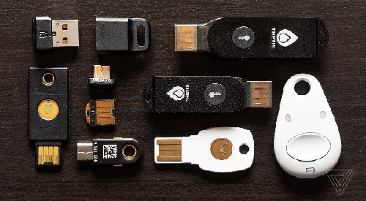
Security key
A security key is an authentication device that strengthens account security when used in addition to a password when signing in. Using a security key is better than receiving codes via phone call or text message because these codes can be phished or intercepted.

Slide 3
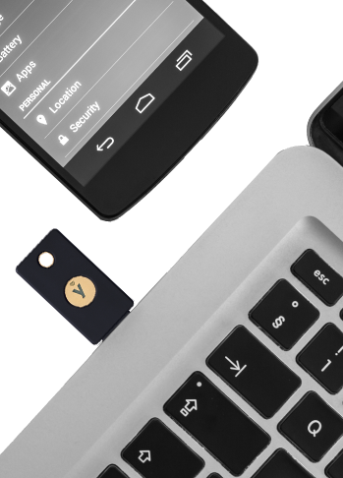
Why use a security key
Security keys are one of the most secure and efficient ways to use Two-Factor Authentication (2FA). When prompted to provide your 2FA credentials, instead of typing in a code, you simply insert your security key and physically tap it when prompted during login.
Google and Yubico created a 2FA called Universal Two-Factor Authentication (U2F).
A U2F Security Key generates a new pair of keys for every service, and only the service stores the public key. With this approach, no secrets are shared between service providers, and an affordable U2F Security Key can support any number of services.

Slide 4
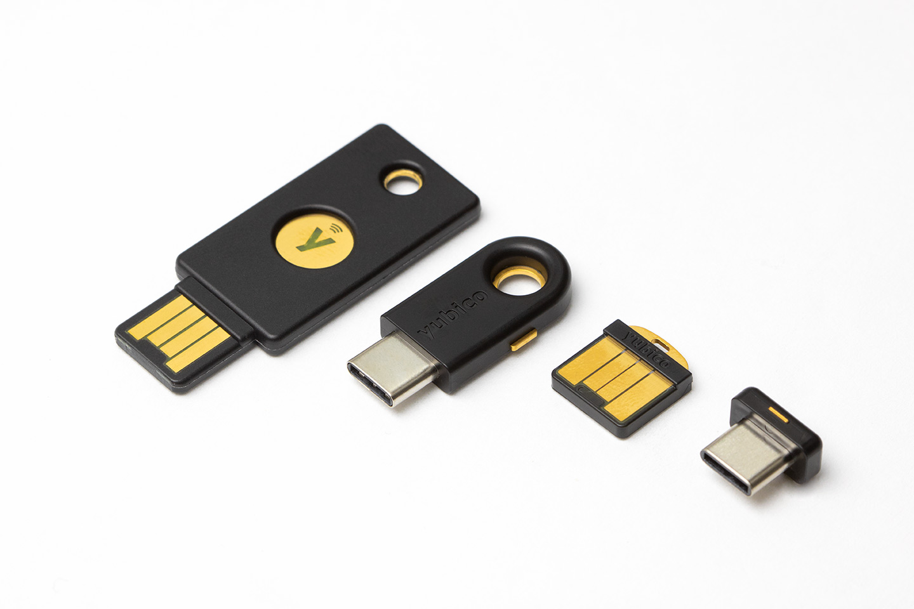
suppliers of security keys
Yubico Yubikey
5 NFC
Good – uses USB-A & NFC, durable, waterproof, and crush resistant
5C/5C NANO
Good – uses USB-C, water-resistant
Bad – tiny so can be misplaced
5 NANO
Good – portable USB-A device, tiny hole for keychain
Bad – not crush resistant, not compatible with mobile devices, connector fully exposed

Slide 5
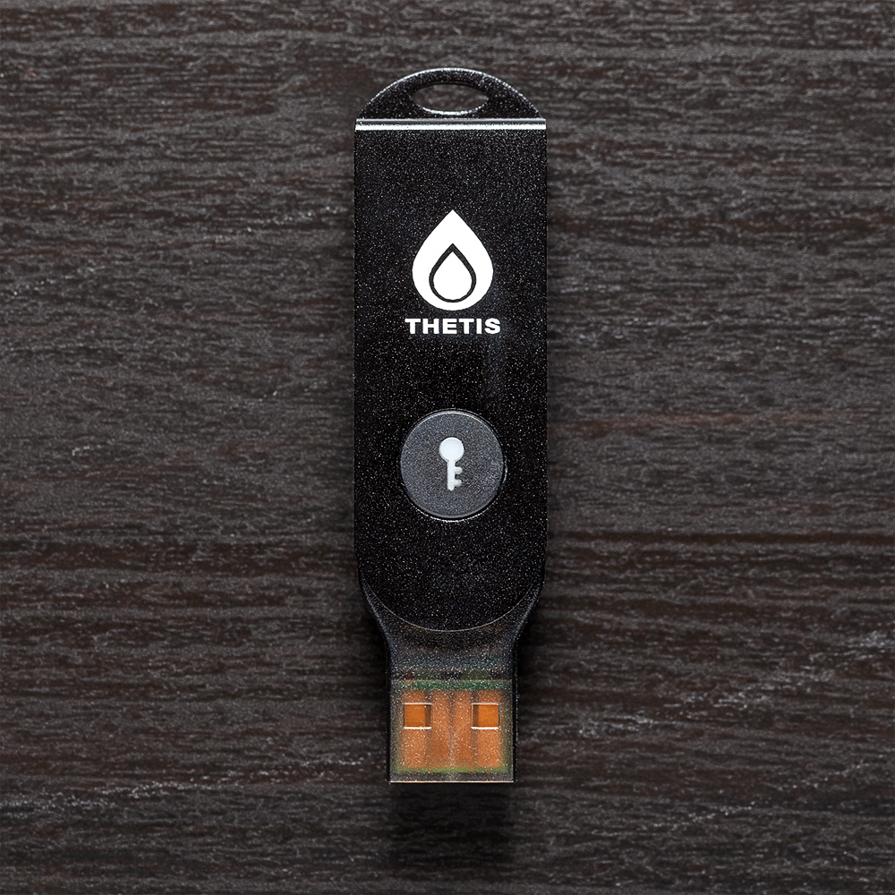
suppliers of security keys (con’t)
Thetis
FIDO (Fast IDentity Online) U2F
Good - aluminum alloy casing rotates 360 degrees, less expensive
Bad – no connectivity to mobile devices, bulkier than other devices
BLE (Bluetooth Low Energy) U2F
Good – bluetooth low energy support use with mobile devices
Bad - bulkier than other devices, requires an app to work with mobile devices

Slide 6
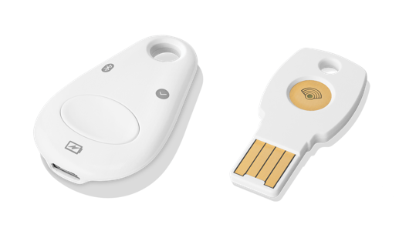
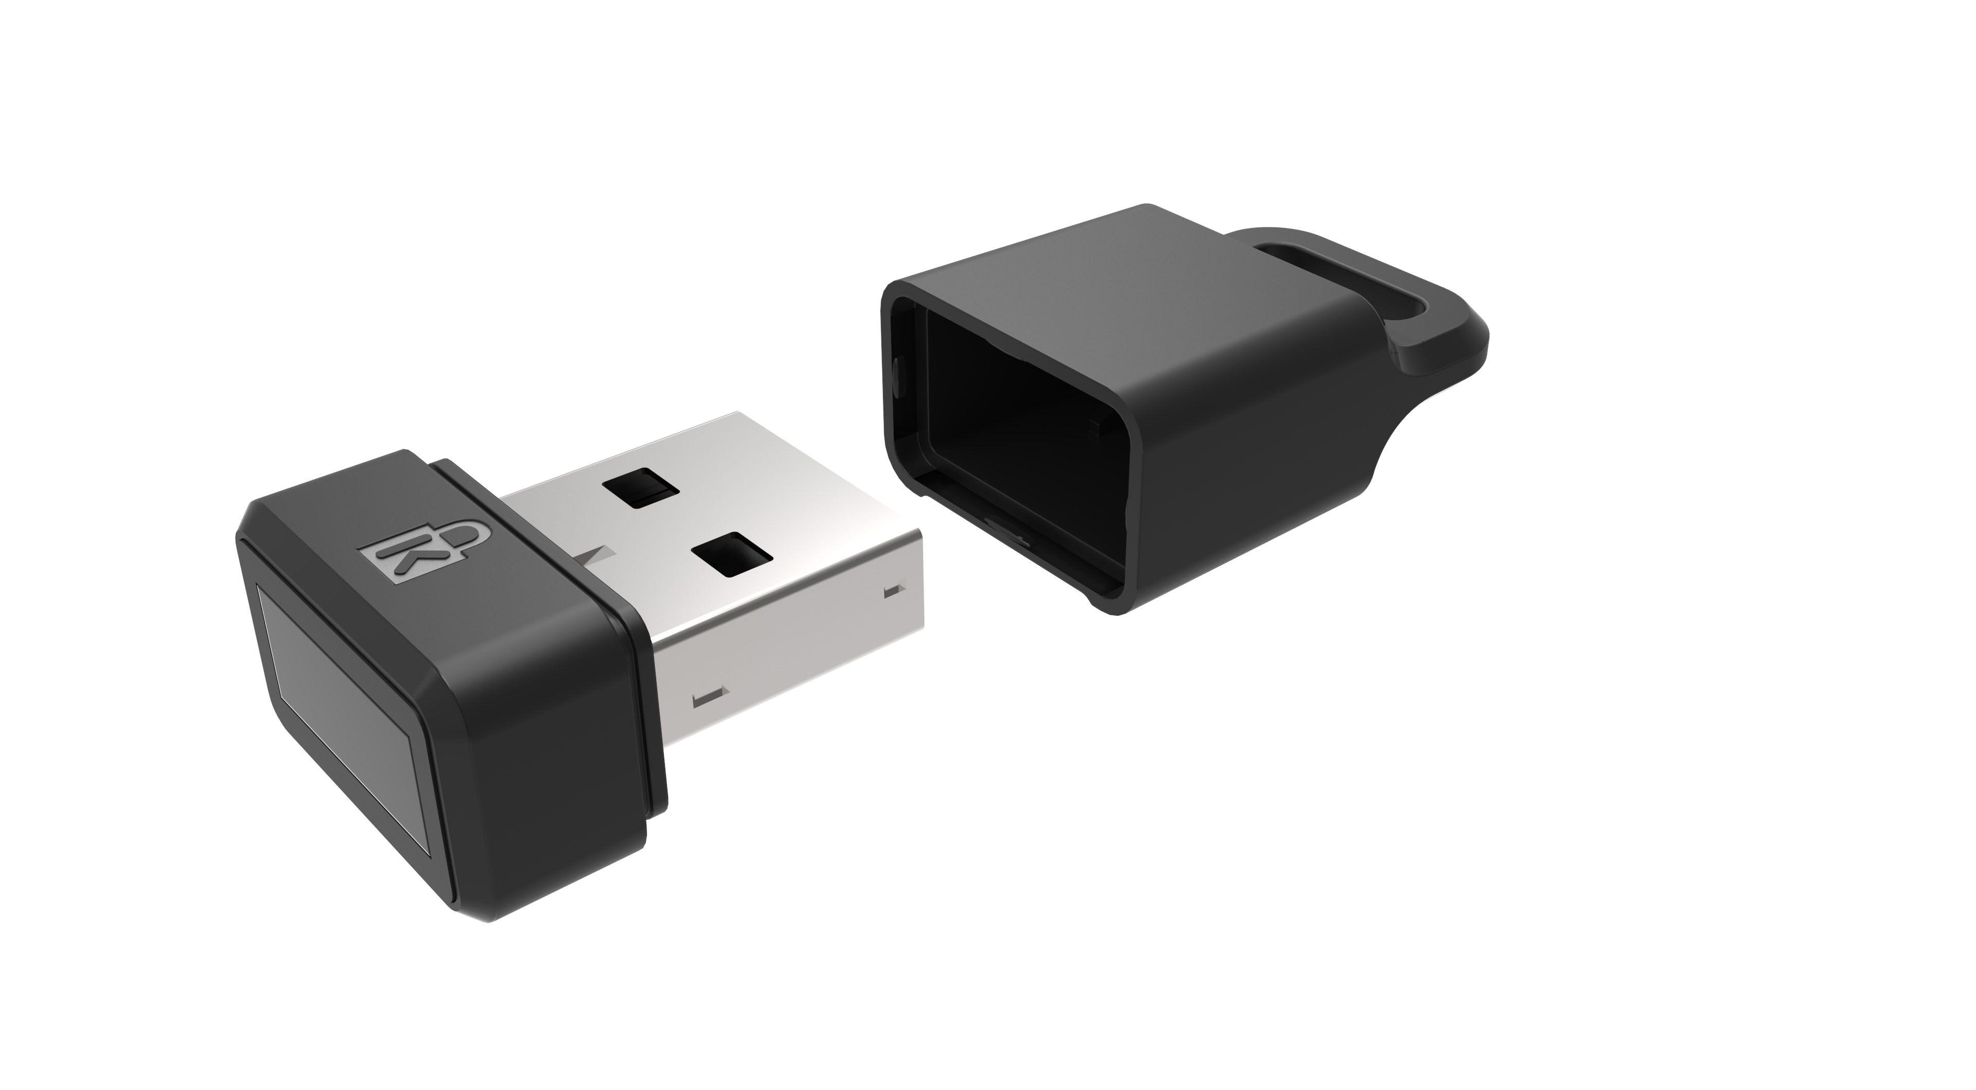
suppliers of security keys (con’t)
Google Titan
Good – comes with 2 keys (USB-A, Bluetooth), supports Google Advanced Protection
Bad – bluetooth takes some setting up, white paint easily chips off on the Bluetooth module, requires you to use the included dongle for USB-C ports
Kennsington Verimark Fingerprint Key
Good – has fingerprint scanner for use with Windows Hello login, conveniently small
Bad – cheap dinky plastic cover, requires driver/system restart to get working fully, can’t be used for mobile devices

Slide 7
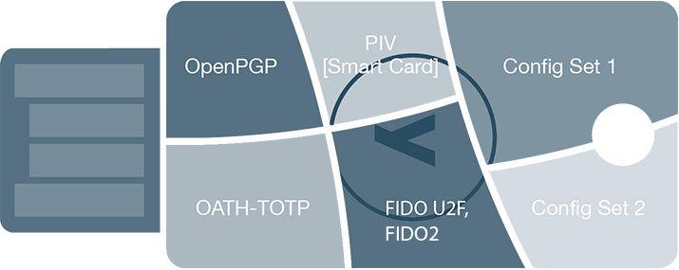
Security key protocols
FIDO U2F
An open authentication standard enabling strong two-factor authentication to any number of web-based applications, such as Gmail, Salesforce, Twitter and hundreds more services. Works via the browser, Chrome today, and Firefox under development, and does not require any client software or drivers.
FIDO2
The latest open authentication standard enabling expanded authentication options including two-factor, multi-factor and now passwordless authentication. With YubiKey support for FIDO2, organizations can accelerate to the passwordless future without the need for any client software or drivers.
OATH – TOTP (Time)
The YubiKey generates a six or eight character, time-based one-time password (OTP) (in conjunction with a helper application) for logging into any service (such as Microsoft Cloud accounts, Google Apps, Dropbox, EverNote) that supports OATH-TOTP, a strong authentication standard. A new password is generated at a set time interval, typically every 30 seconds.
PIV-Compatible Smart Card
Smart cards contain a computer chip that brokers data exchanges. These same features are contained in the YubiKey 5 Series, based on the industry standard Personal Identity and Verification Card (PIV) interface over the CCID protocol, which supports PIV on a USB interface.
OpenPGP
In the physical world, documents and data are often validated with a signature. In the virtual world, OpenPGP is a standards-based public key cryptography for signing, encrypting, and decrypting texts, e-mails, files, etc.

Slide 8
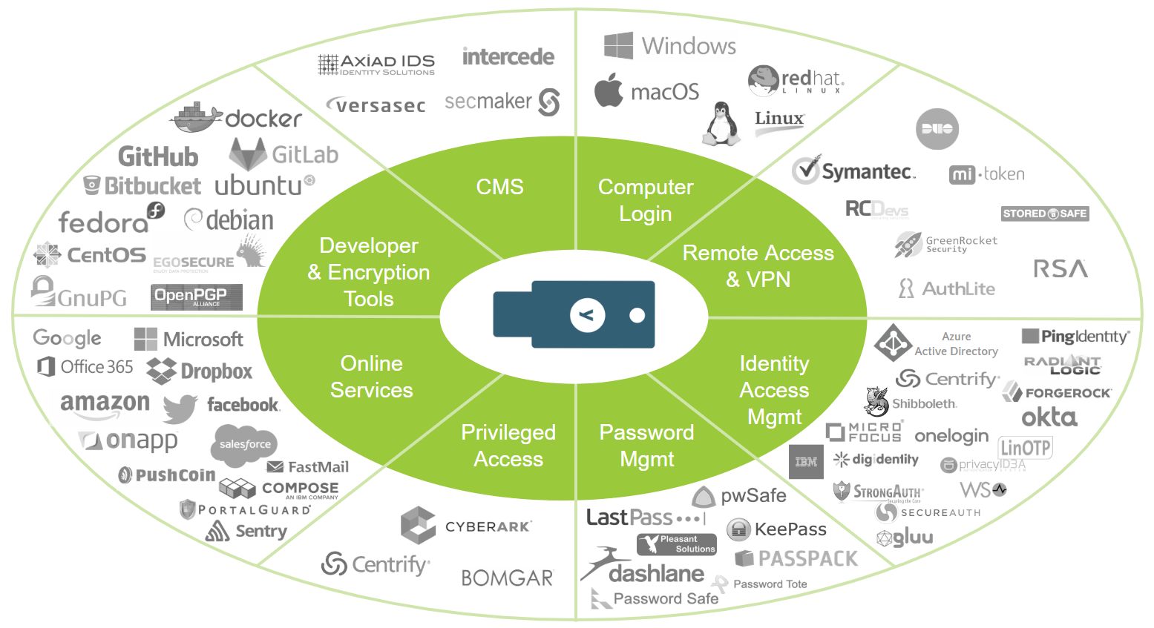
Where can security keys be used?
Catalog for hundreds of services that work with the Yubikey
https://www.yubico.com/works-with-yubikey/catalog/

Slide 9
DEMO

Slide 10
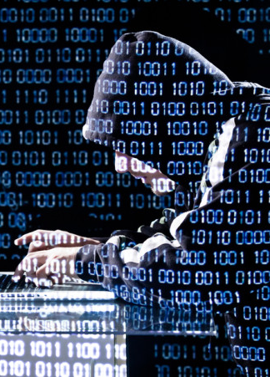
Are security keys hackable?
Not yet, but just because it hasn’t or didn’t (not sure how you ultimately prove that of course) get hacked, doesn’t mean it can’t be hacked.
Google has told the world that none of its 85,000 employees had been successfully hacked since they started implementing Security Keys in early 2017.

Slide 11
Are security keys hackable? (con’t)
Security Keys are susceptible to 8 out of the 10 more popular attacks
Man-in-the-Endpoint
Fake Web Sites and Fake Authentication Experiences
Downgrade/Not Required Attacks
Tech Support Social Engineering Attacks
Hijacking Shared Authentication Attacks
Subject Hijacking
Buggy Code
Physical Attacks
A hack found a specific design flaw with the U2F design when using WebUSB, but was reported and corrected.
Many times, it isn’t a design issue, it’s a human issue.
E-BOOK - 12+ Ways to Hack Multi-Factor Authentication by Roger Grimes

Slide 12
summary
Adding two-factor authentication remains one of the most basic and crucial steps to protecting your sensitive accounts, and a U2F token like a Yubikey is the most secure form of that protection you can use. Even two-factor authentication methods like text messages or Google Authenticator still rely on temporary codes that the user enters when they log in; a convincing phishing site can simply trick you into handing over those codes along with your username and password. A U2F token like the Yubikey instead performs an authentication handshake with a website that not only proves to a website that it's your unique key, but requires that the website prove its identity too, preventing lookalike sites from stealing credentials.

Slide 13
?
Questions

